Slide 1

QER - 5124
QER: BID 141KM SF300065C004.9X – Zeta wire damage

Slide 2
Pipe section / Details
Item | Traceability / identification
Project number | SF300065C004
Project name | BID 141KM
Pipe section | SF300065C004.9X
ST number | ST101.51896
Affected layer / equipment | Spiralling
Length affected | 1949.3m
Drawing number / MP code / STA / Dimension | Zeta 6.2 FI09 (MP205)

Slide 3
Overview of anomaly
Problem Description :-
During the zeta spiraling process for BID 141KM SF300065C004.9X (ST10151896), zeta wire damage was detected at length 1949.3m.
Root Cause :-
From the preliminary investigation, the root cause is most likely due to wire damage toward end of coil due to worn out flange during winding.
Problem Handling:-
Production performed un-spiralling and removed affected wires and re-weld before proceed process spiralling as usual. Dimensional after repaired are all within criteria and accepted as per DP-QCP-08DAQT001

Slide 4
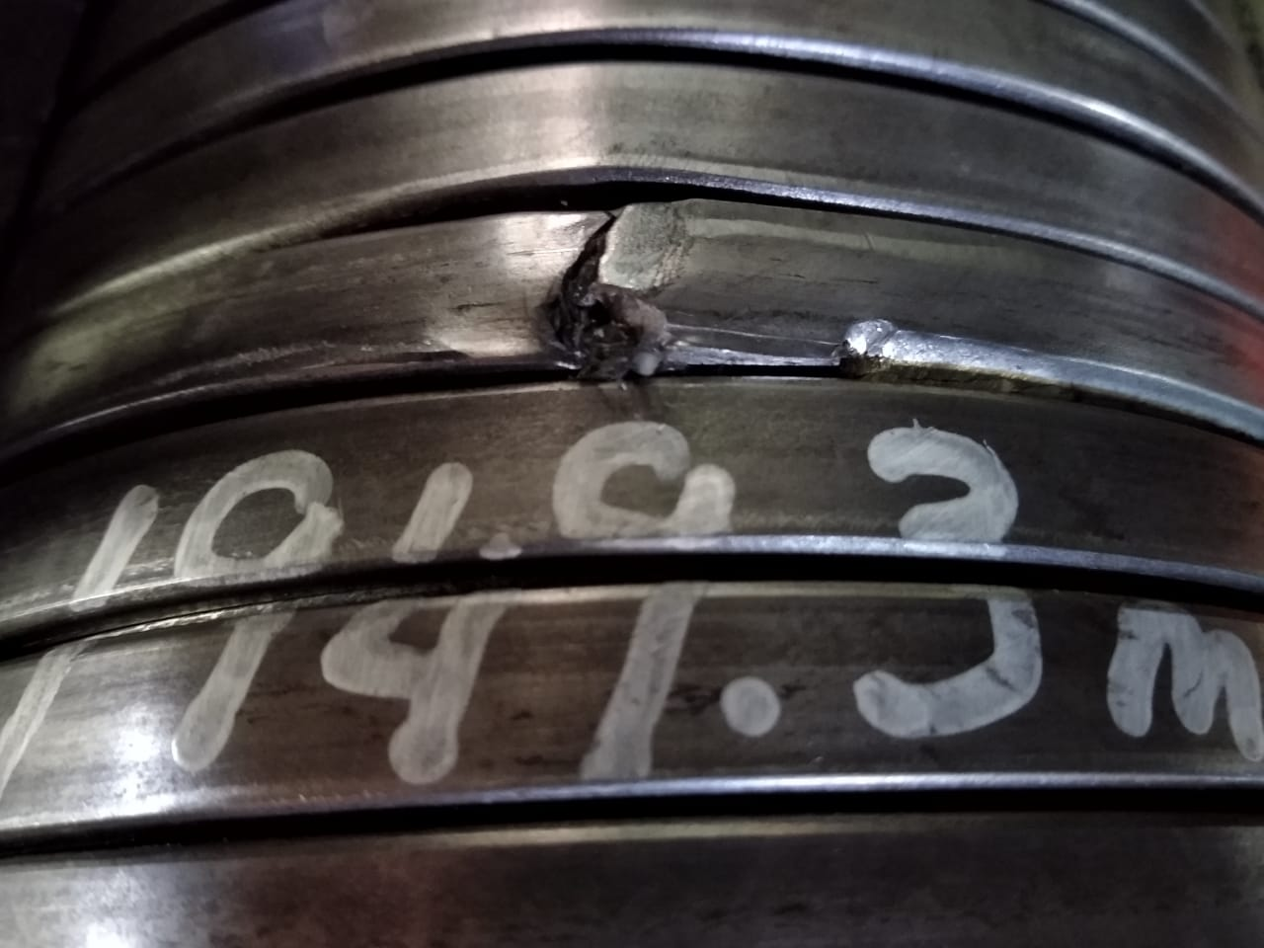
Wire damage at length 1949.3m photo
Figure 1 : Zeta wire damage was detected at length 1949.3.

Slide 5
After repaired 1949.3 m Photo
Figure 2 : Cut and re-weld xx-xx from (BS13-12)

Slide 6

THANK YOU

